Slide 1
Persistence

Slide 2
Persistence
PlayerPrefs.
Json Utility

Slide 3
PlayerPrefs
They only support values ​​of type Float, Int and String, which limits the serialization of large and complex objects.
The generated files are managed directly by the Operating System, which can make their portability and control difficult.
All data is stored in a single file, which can affect performance and organization if a large amount of information is being handled.

Slide 4
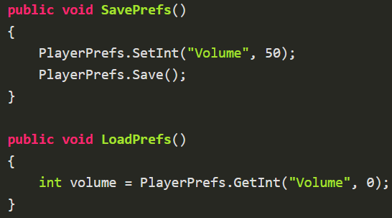
PlayerPrefs
They lack security mechanisms, so data can be easily modified, making them vulnerable.
Despite their limitations, they are simple to implement, making them a quick option for small projects or prototypes.
PlayerPrefs Editor in Asset Store.

Slide 5
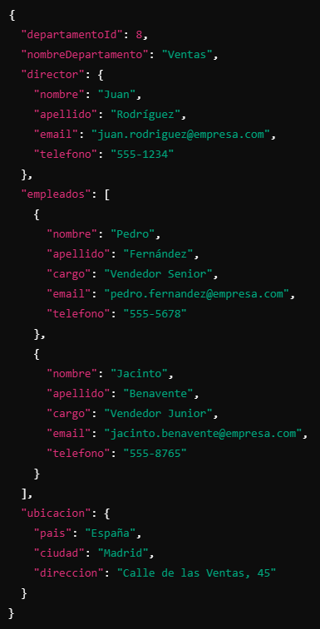
JSON
It is a lightweight, plain text format used to store and transmit data.
https://es.wikipedia.org/wiki/JSON

Slide 6
JSON Utility
It is Unity's native API for de/serializing data in JSON format.
It shares the same limitations as Unity's internal serializer.
It is our responsibility to manage where the serialized data will be stored, whether in a secure location locally or in an external location over the network.

Slide 7
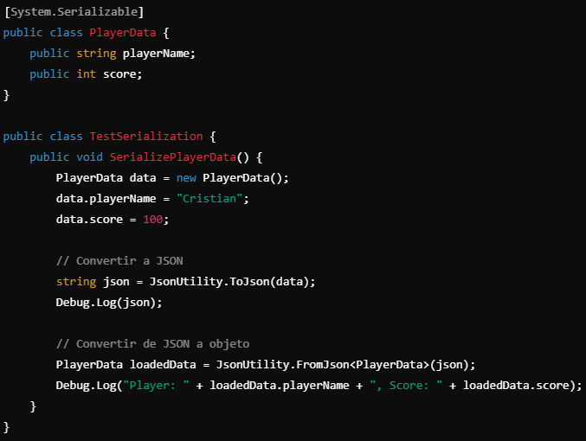
JSON Utility

Slide 8
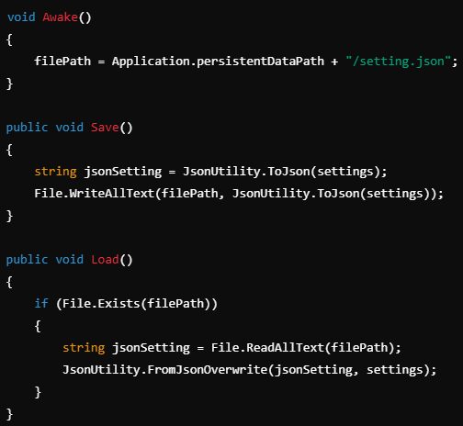
Save JSON to disk

Slide 9
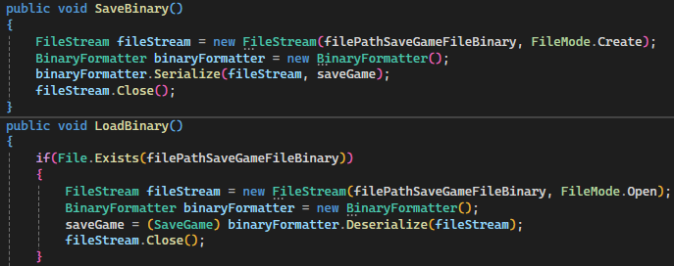
Binary Serialization
Security: Data is not easily readable and modifiable by humans.
Efficiency in size and loading times.
Support for complex structures.

Slide 10
Exercise
Options data and 3 saved game slots must be saved.
We should be able to save by playerPrefs, JSON and binary serialization.
Options and saved game data must be saved in 2 different files.

